Slide 1
Virtual Local Area Networks

Slide 2
Virtual Local Area Network (VLAN)
Virtual LAN is a strictly logical system built on L2 which allows you to seperate what would normally be a single L2 network into subgroups by enforcing rules on what switch ports can communicate with each other
Provides for easier management and scalability of networks by subdividing broadcast domains into smaller groups without the need for most L2 devices to be aware of the change and without using L3 routing
Provides a layer of security by segmenting networks, which can also be used to meet compliance requirements
Uses the IEEE 802.1Q tag format to perform the VLAN segmentation, this is often referred to a Dot1Q

Slide 3
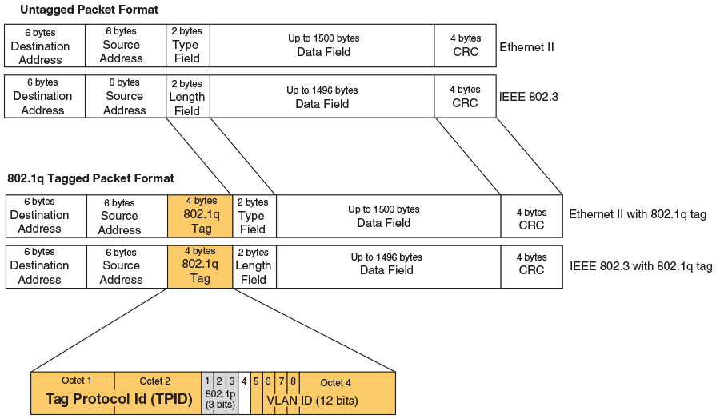
Notes:
16 bit tag protocol id (set to 0x8100 to identify it as a .1Q tagged frame), which is also used with other values by other protocols
3 bit priority level (0-7)
1 bit canonical format indicator for the MAC address type
12 bit VLAN ID (0-4095)

Slide 4
How VLANs Segment Traffic
Ports on the switch are configured to be part of a specific VLAN (1-4095 with 0 being designated for non-VLAN’d ports by default)
When traffic enters the switch on a particular port, it is converted from a typical frame to a Dot1Q frame and the VLAN tagged to the port that data travels on is added as the VLAN ID field to the Dot1Q frame
The destination MAC address is then looked up in the switching table and the associated VLAN for the port associated with that MAC address is viewed
If the VLAN in the switching table and the VLAN for the incoming frame match, then the frame is forwarded, otherwise it is not

Slide 5
R1
R2
SW1
SW2
SW3
SW4
SW4
6 Clients
9 Clients
2 Clients
5 Clients
:01.1
:A1.1
:B1.2
:C1.3
:D1.2
Record ID | Port | MAC Address | VLAN
1 | fa0/0 | 00:00:00:00:00:01 | .1
2 | fa0/1 | 00:00:00:00:00:A1 | .1
3 | fa0/2 | 00:00:00:00:00:B1 | .2
4 | fa0/3 | 00:00:00:00:00:C1 | .3
5 | fa0/4 | 00:00:00:00:00:D1 | .2
Notes:
The ports here are annotated faX/Y where fa stands for fast ethernet (the typical networking port type for local networks), X stands for the module number (0 typically unless the device has multiple network interface components) and the Y stands for the port number.

Slide 6
R1
R2
SW1
SW2
SW3
SW4
SW4
6 Clients
9 Clients
2 Clients
5 Clients
:01.1
:A1.1
:B1.2
:C1.3
:D1.2
How many broadcast domains exist?
How many VLANs exist?
Can VLAN .2 and VLAN .1 communicate?
Notes:
There are three broadcast domains, since each VLAN will establish an independent broadcast domain. That means there are also three VLANs. VLAN 2 and VLAN 1 cannot communciate because they would need to do so through L3 as they represent logically separate networks from the switches point of view.

Slide 7
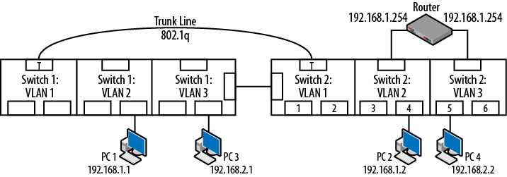
Trunking
Special port designation that allows traffic from multiple VLANs to traverse over a single port, allowing switching over multiple appliances
Combining VLANs, trunk lines, and a router together allows for traffic to traverse across VLANs using something called “router on a stick”

Slide 8
R1
R2
What happens when you try and communicate between :B1 and :E1?
What happens when you try and communicate between :A1 and :F1?
SW1
SW2
SW3
SW4
6 Clients
9 Clients
2 Clients
5 Clients
R2
Trunk
SW4
Trunk
SW3
:01.1
:A1.1
:B1.2
:C1.3
:D1.2
:E1.2
:F1.3
Notes:
When you communicate between B1 and E1, the B1 frame moves to SW4 and is transformed into a Dot1Q frame with a VLAN ID of 2. That frame is then transported across the trunk line to SW3, where the Dot1Q frame is read to have a VLAN ID of 2. Since the entry for E1 in the switching table shows its particular port and a VLAN ID of 2 for E1, it forwards the traffic to the host on the registered port after stripping out the Dot1Q portions of the packet.
When you try and communicate between A1 and F1 the same first step happens where the frame from A1 is converted into a Dot1Q frame with the VLAN ID of 1. At this point it cannot forward the traffic to SW3 because F1 is (as far as its concerned) not a host attached to SW3. Instead, it sends the traffic to R2 which will remove the frame portion and inspect the IP address. The IP address will be part of the IP range matching VLAN 3 (which it gets from L3 IP to MAC mapping) and it will then send out the traffic back to SW3 but intended for VLAN 3. It is important to note here that that this works because each VLAN has an independent IP range (and an independent connection to SW4 for each range?) so the traffic coming in will be different from what was sent out to the router. When SW4 receives the new frame it will convert it to a Dot1Q frame with a VLAN ID of 3, which can then be forwarded to SW3 and on to F1.

Slide 9
R1
R2
Notice that SW3 doesn’t contain any hosts in the .1 VLAN
We can disallow traffic of Dot1Q frames with a VLAN ID of .1 over the trunk line in a (manual) process known as pruning
SW1
SW2
SW3
SW4
6 Clients
9 Clients
2 Clients
5 Clients
R2
Trunk
SW4
Trunk (VLAN ID .2 - .3)
SW3
:01.1
:A1.1
:B1.2
:C1.3
:D1.2
:E1.2
:F1.3

Slide 10
Questions?

Slide 11
Additional Resources
Packet Guide to Routing and Switching - Chapter 4: VLANs and Trunking

